Slide 1
APP Training 101
JULIANNE HADDAD & JASMINE CORBIN

Slide 2
Raise your hand!
Have an iPhone?
Android?
Instagram?
Kik App?
Snapchat?
Ask.fm?
Twitter?

Slide 3
How many of these apps have you heard of?
Notes:
Sarahah http://www.bbc.com/news/av/world-middle-east-40846321/sarahah-the-honesty-app-that-s-got-everyone-talking

Slide 5
QUESTIONS
What did you think about the clip?
Has anything like this ever happened to you or someone you know?
What are you doing to be safe against predators?

Slide 6
Notes:
Activity

Slide 7
Downfalls to using apps
-Cyberbullying
-Decrease in productivity
-Destroys social skills
-Comparison fuels jealousy/ low self esteem
-Anxiety over how many “likes”, “followers” and “retweets”
-Predators can locate where you are

Slide 8
It’s not all bad…
-Share pictures and short videos
-Artistic expression
-Keep in touch with loved ones
-Easy way to connect others
-Fast way to find news; keep up to date w/ the world

Slide 9
Helpful Apps for Anxiety
Mindshift AnxietyCoach Worry Watch

Slide 10
Helpful Apps for Depression
Pacifica Moodkit Happiify

Slide 11
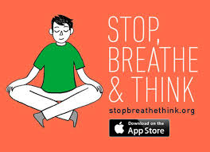
Helpful Apps for Meditation
Stop, Breathe & Think Headspace Smiling Mind

Slide 12
Helpful Apps for Sleeping
Sleep Genius Sleep Pillow Sounds Sleep Cycle Alarm Clock

Slide 13
Other Important Apps

Slide 14
Questions?
Thank You!

